Slide 1
Spray Formed - Premium quality tool steel
Enhanced powdered metal
Higher toughness
Higher wear resistance
Improved toughness and chip resistance
PSB 27
Only from SB Specialty Metals
Your First Choice for Specialty Metals
Notes:
Use this information but maybe update the format to bullet points.

Slide 2
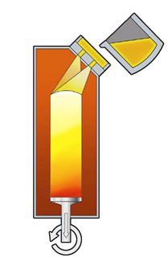
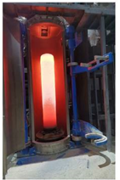
The Spray Forming Process
Melting furnace
Tundish
Atomizer system
(inert gas)
Spray chamber
Spray formed billet
Collector

Slide 3
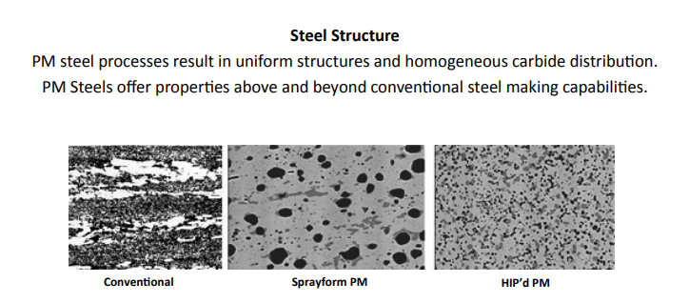
Microstructure

Slide 4
What are the advantages
Very uniform/homogeneous microstructure
Improved mechanical properties –
Wear resistance
Toughness
Increased hardness
Freedom from macro-segregations
Improved dimensional stability in heat treatment

Slide 5
PSB 27

Slide 6
Applications
Non-woven industry
Rolling - steel processing industry
Recycling industry
Slittering
Blanking and Forming
Steel Stamping
Cutting
Powder Compaction
Brick Forming
Sand blasting
Threading
Forming autoparts

Slide 7
Case Study - Rotary Die Cutting Non-woven Material – Die for a pad machine final cutter.
10” Diameter Rotary Die
Rotary Crush Die
 | PSB 27 | Conventional D2
Production | 84 million | 34 million
Condition | No indications of microcracks | Micro Crack indications

Slide 8
Financial Benefits Model
Total Lifecycle Model- Rotary Die – Non-woven

Slide 9
Case Study - Cutting wallpaper structured with wood fibers
16” Dia x .183 Cutting Wheel
Additional notes from study
 | PSB27 | Conventional D2
Run time before regrind | 360 hours | 240 hours
Tool hardness | 60 HRC
PSB27 | Conventional D2
The production down time was reduced due to a keener edge on the knife, resulting in less maintenance time | Several production stoppages due to blockages of weed fibers between knife.

Slide 10
Case Study – Threading Die, Threading material – High Strength Steel, with profile tolerance of +/- 0.05
Die Life
Die photo
 | PSB27 | Conventional D2
Hardness | 63 HRC | 61 HRC
Die Lifetime | 600 hours | 200 hours

